Slide 1

The Data of Storytelling
The State of Computational Narrative Understanding
Andrew Piper
McGill University
November 3, 2023

Slide 2
Why do people do things?
Make financial decisions
Make political choices
Feel mentally well
Experience joy
Believe information
Have a sense of social belonging
Stories!!

Slide 3
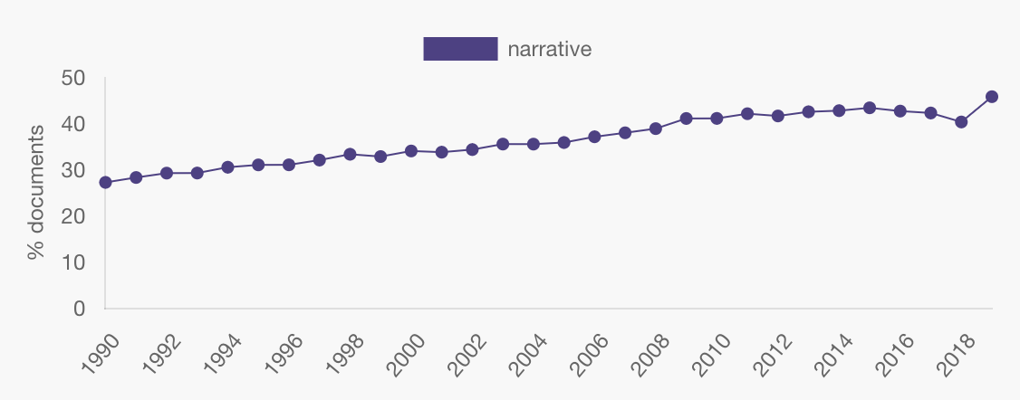
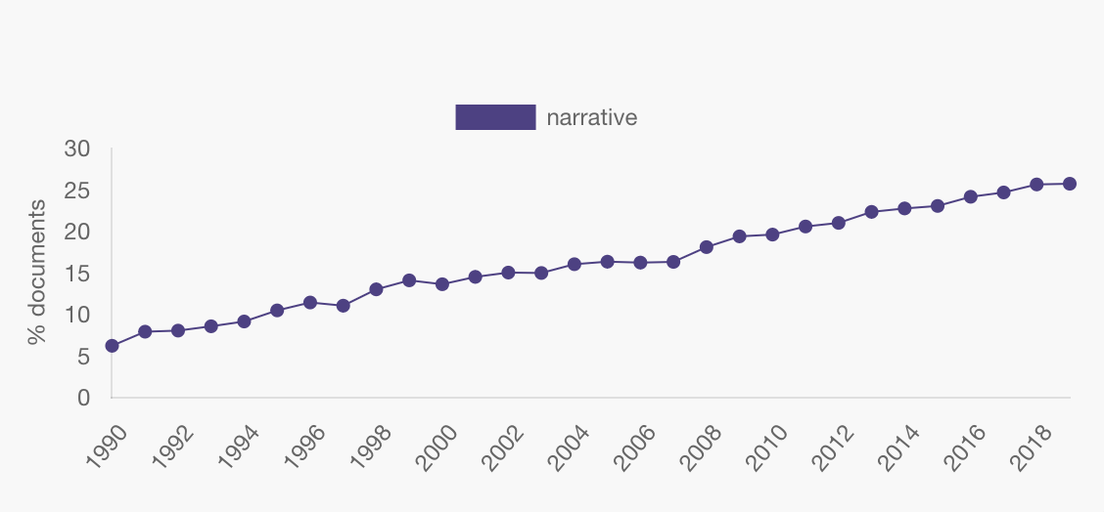

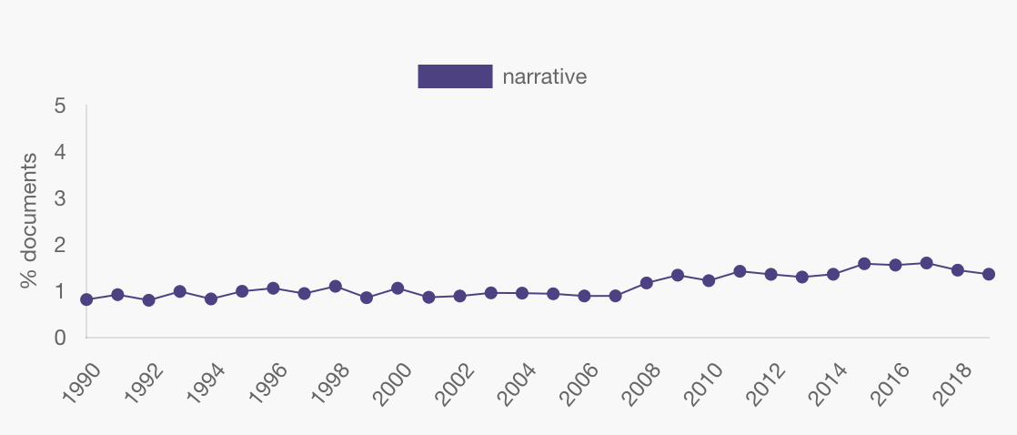
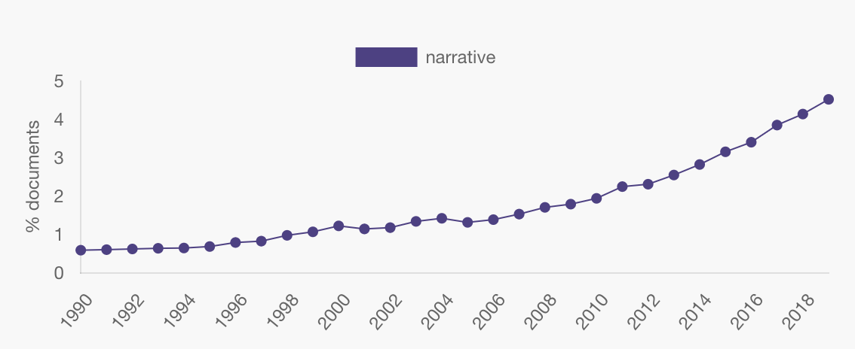
The rise of story talk
Arts
Source: JSTOR
Social Sciences
Physical Sciences
Health Sciences

Slide 4
The spread of story talk
Adler et al. (2016). The incremental validity of narrative identity in predicting well-being. Personality and Social Psychology Review, 20(2), 142-175.
Bushell et al. (2017). Strategic narratives in climate change. Energy Research & Social Science, 28, 39-49.
Shiller, R. J. (2020). Narrative economics: How stories go viral and drive major economic events. Princeton.

Slide 5
The fear of story talk
Brooks, P. (2022). Seduced by Story: The Use and Abuse of Narrative. NYRB.
Gottschall, J. (2021). The story paradox: how our love of storytelling builds societies and tears them down. Hachette.
Salmon, C. (2017). Storytelling: Bewitching the modern mind. Verso.

Slide 6
The Plan
Latest findings from my lab
The red thread of storytelling & embodied consciousness
A new focus on “collective stories”

Slide 7
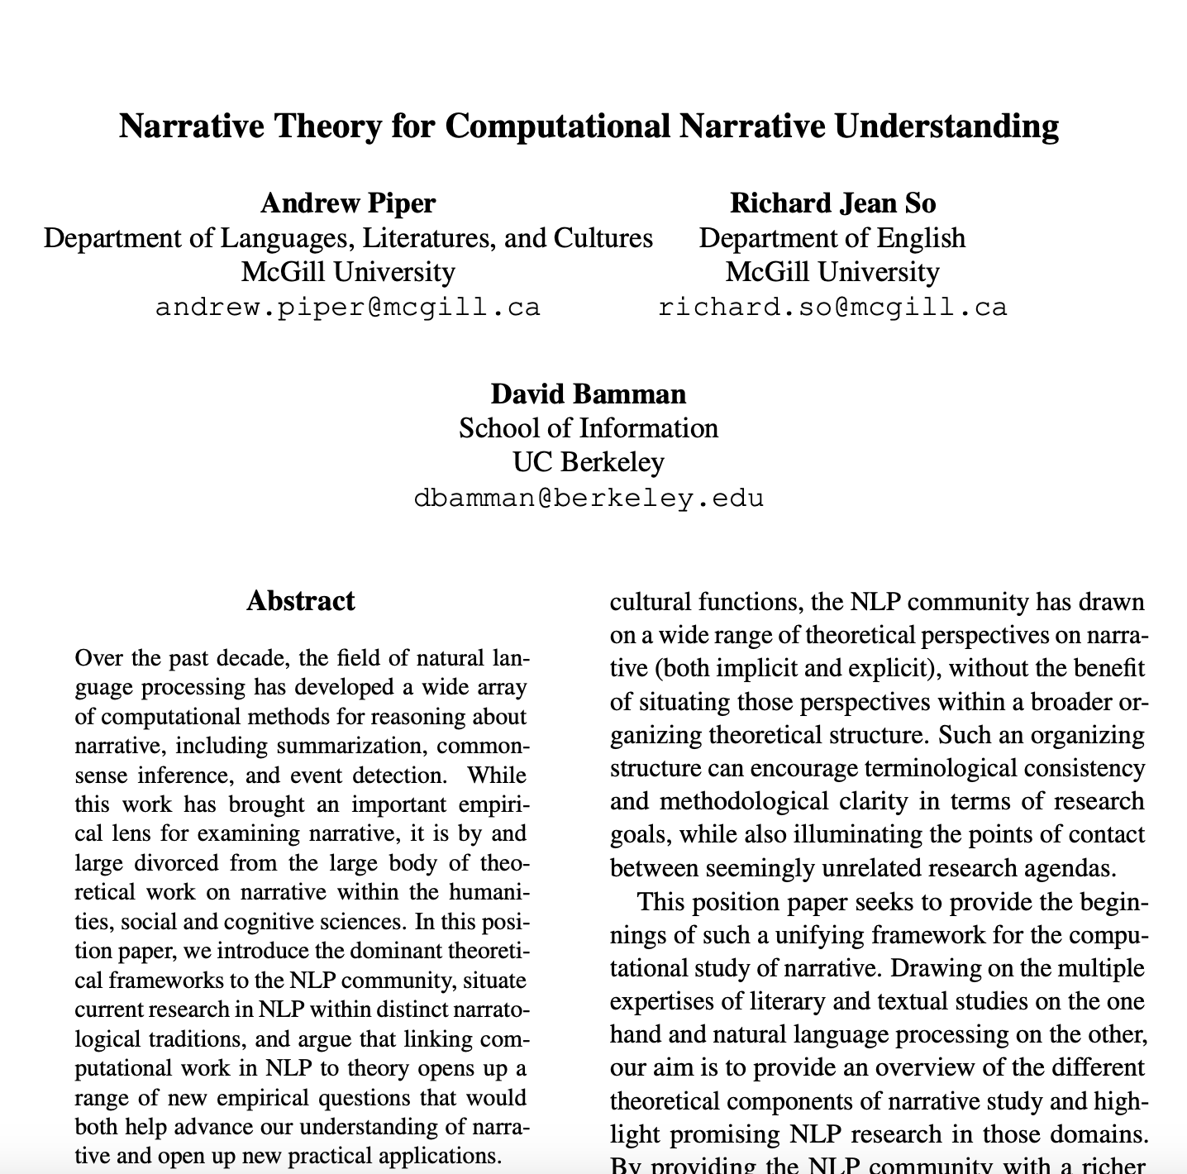
Overview
Piper, A., So, R. J., & Bamman, D. “Narrative theory for computational narrative understanding.” EMNLP 2021

Slide 8
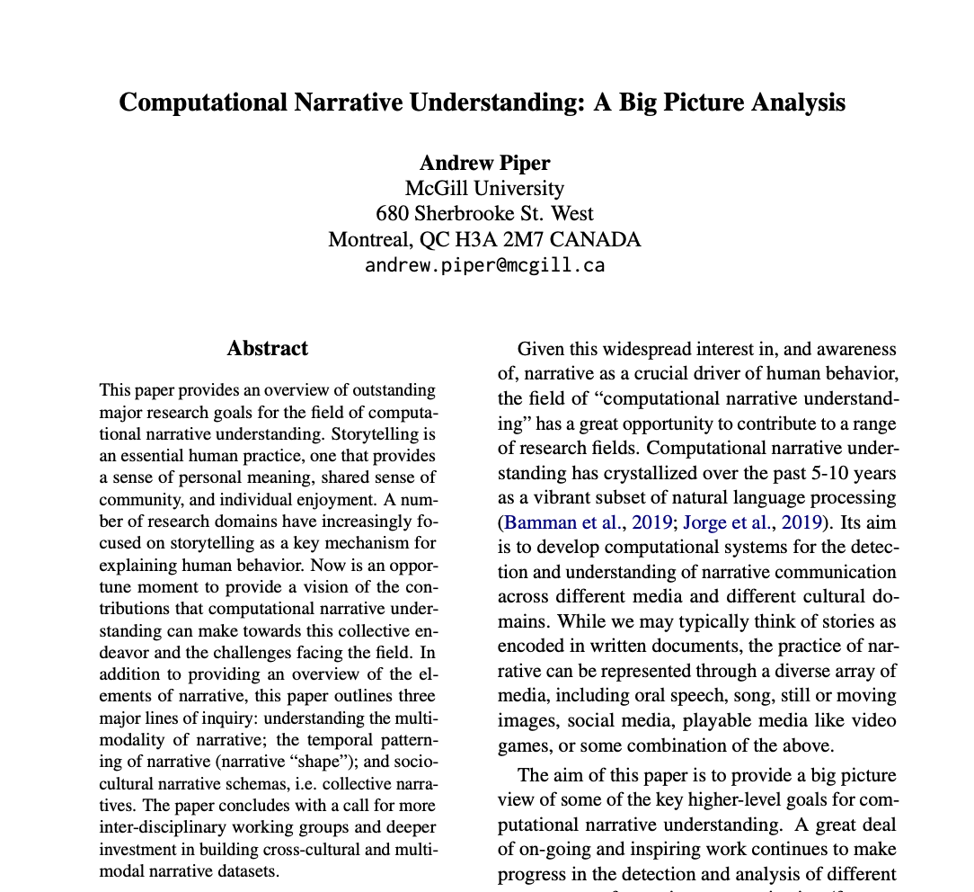
Overview
Piper, A., So, R. J., & Bamman, D. “Narrative theory for computational narrative understanding.” EMNLP 2021
Piper, A. “Computational Narrative Understanding: A Big Picture Analysis.” EMNLP 2023

Slide 9
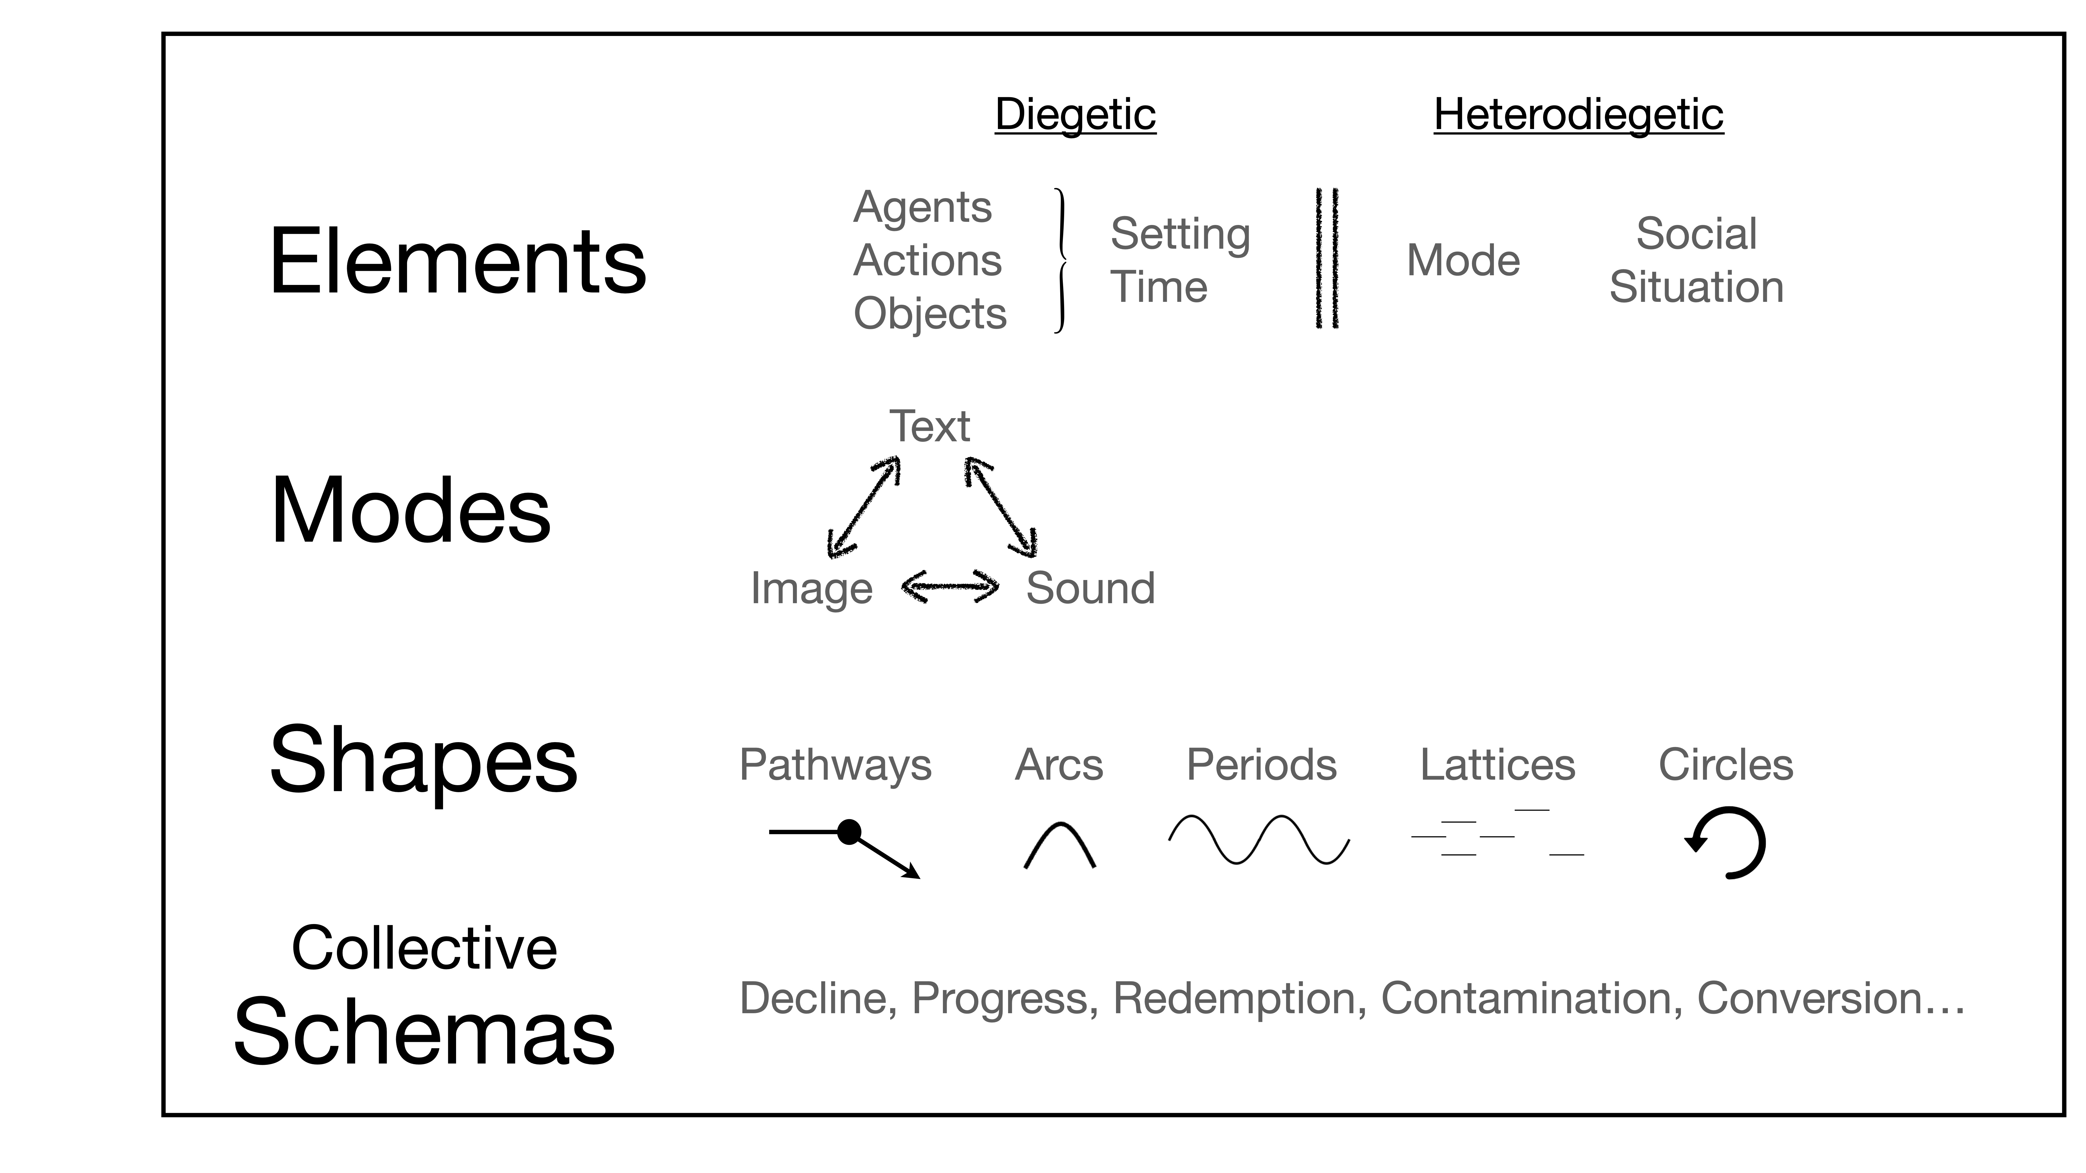
Overview
Piper, A. “Computational Narrative Understanding: A Big Picture Analysis.” EMNLP 2023

Slide 10
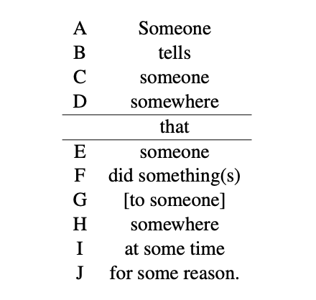
A minimal definition of a story
Piper et al. (2021). Narrative theory for computational narrative understanding. EMNLP.
(A) teller, (B) mode of telling (i.e. medium), (C) recipient, (D) social situation, (E) agent, (F) at least one action or event, (G) possible object, (H) location, (I) time-frame, (J) motivation or cause of the actions involved.

Slide 11
One time when I was in 6th grade I was getting ready for school in the morning. I remember getting breakfast and sitting down at the kitchen table. I heard footsteps going down to the basement. At first I thought it was my dad because usually he would wake up to me going downstairs. But I heard my dad's loud snoring from the bedroom. […]
For sale: Baby shoes. Never worn.
- Ernest Hemingway
- AskReddit

Slide 12
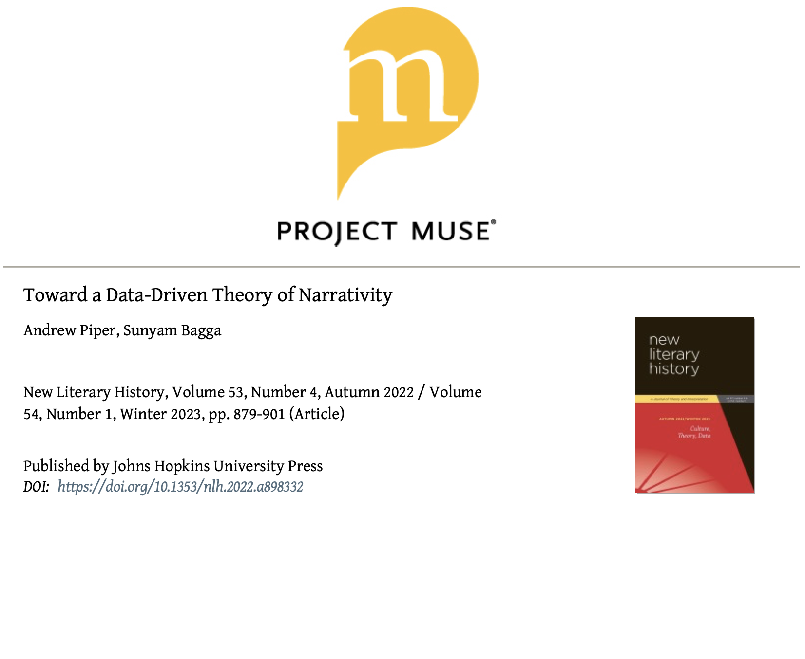
What kind of communication is narration?
13,543 passages across 18 genres.
  STORY: Biographies, Memoirs, Fairy Tales, Novels, Reddit, Short Stories, Flash Fiction
  NON: Abstracts, Aphorisms, Academic Articles, SCOTUS
Feature space:
  POS+“Time-Setting-Perspective”
  Agency, Concreteness, Feltness, Eventfulness, Setting, Time, etc.

Slide 13
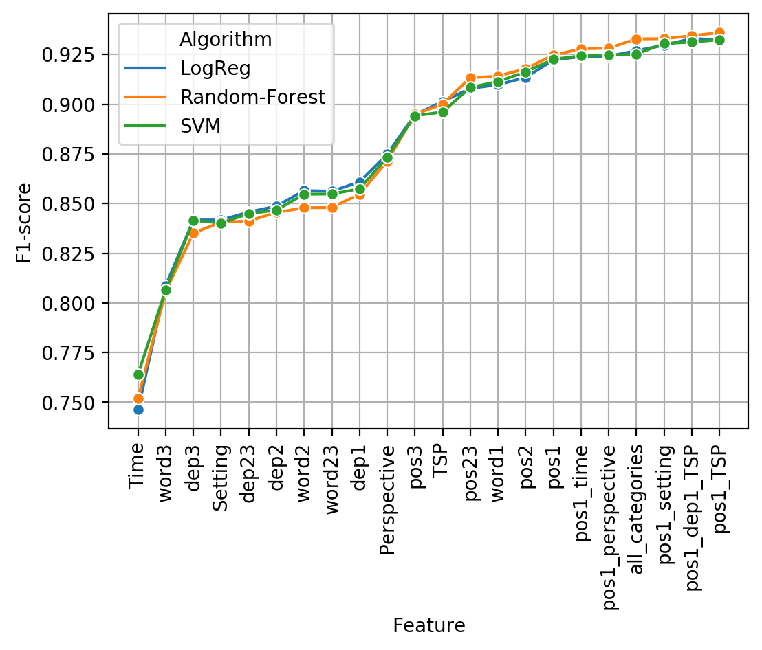
Best Model | F1 | Precision | Recall
Random Forest | 0.936 | 0.927 | 0.945

Slide 14
Reader Judgments
Condition | F1 | Rho
Random Forest | 0.89 | 0.79
Book-reviews removed | 0.93 | 0.82
GPT-4 | 0.89 | 0.75
0.81/0.98
Total Passages
394

Slide 15
GPT
Condition | F1 | Rho
Random Forest | 0.89 | 0.79
Book-reviews removed (RF) | 0.93 | 0.82
GPT-4 | 0.89 | 0.75
0.81/0.98
Total Passages
394

Slide 16
Positive Predictors:
agenthood (animate entities)
vbd (past tense verbs)
concreteness (concrete vocabulary)
Negative Predictors
nn (nouns)
vbz (participles)

Slide 17
Theory of narrative
Prior theory
Attentionality [narrator fitness]
Information [managing the future]
Cohesion [shared belief]
Our models
Focalization [Agency]
Concretization [Immersive]
Distantiation [Deictic]

Slide 18
Theory of narrative
Prior theory
Attentionality [narrator fitness]
Information [managing the future]
Cohesion [shared belief]
Our models
Focalization [Agency]
Concretization [Immersive]
Distantiation [Deictic]
Fostering joint attention to develop shared intentions
Tomasello, M. (2010). Origins of human communication. MIT press.

Slide 19
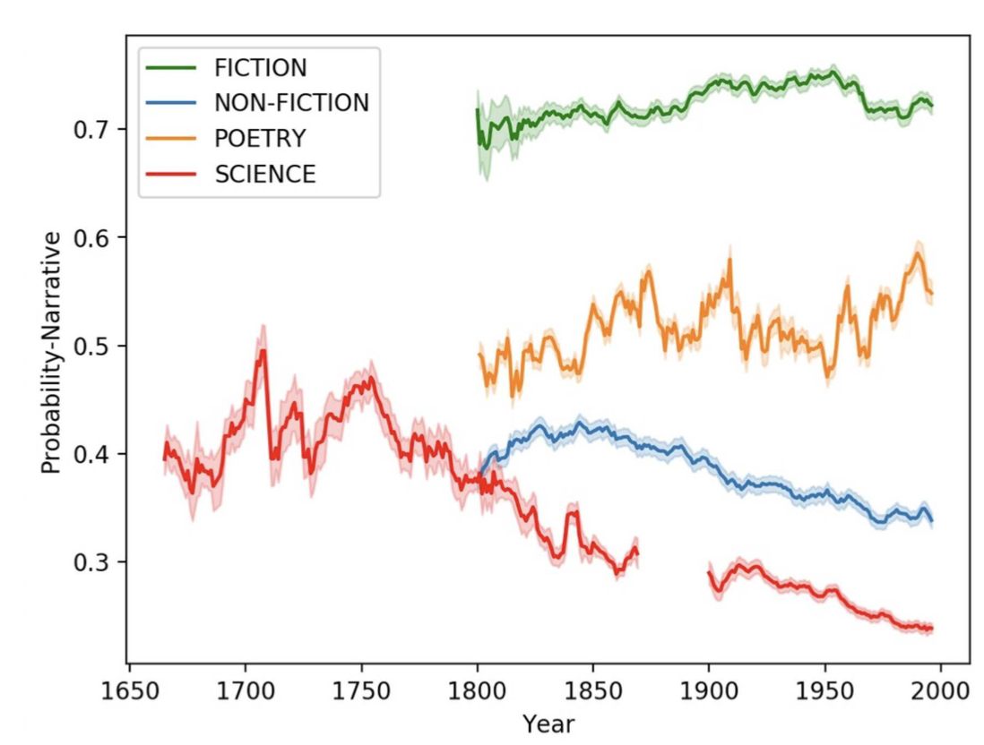
Detecting narrativity
Piper, A. et al. (2021). Detecting narrativity across long time scales. Proceedings of the Computational Humanities Research Workshop (CHR 21).

Slide 20
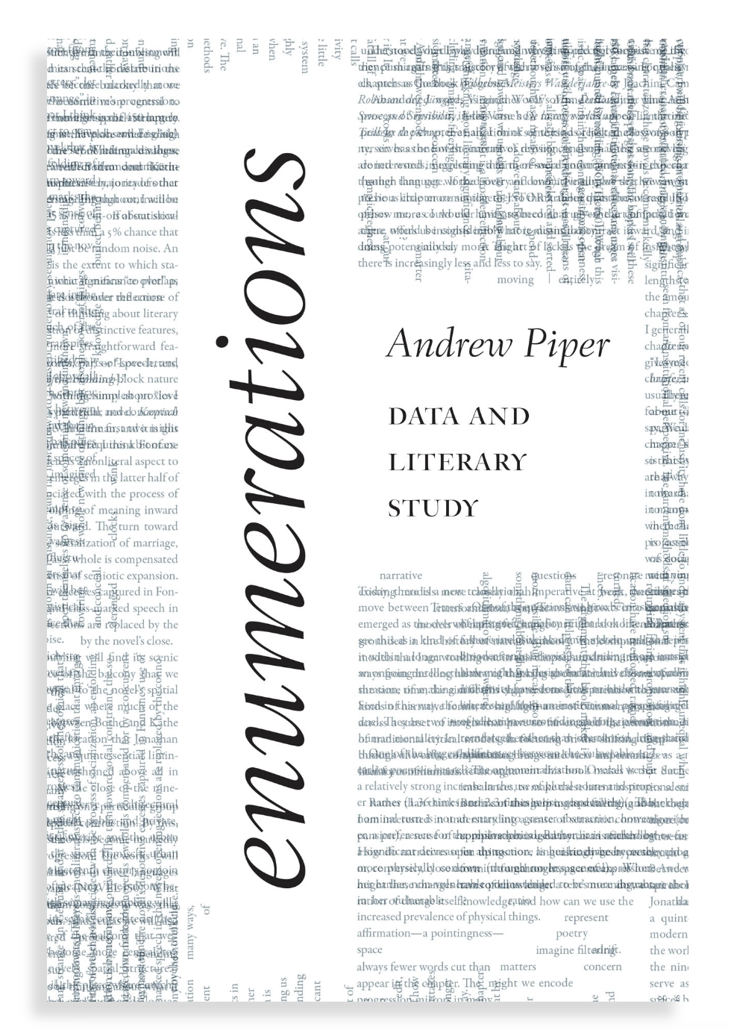
What kind of communication is fictional narration?
Piper, A. (2022). The CONLIT dataset of contemporary literature. Journal of Open Humanities Data, 8.
  2,700 books / 12 genres
Bagga, S., & Piper, A. (2022). HATHI 1M: Introducing a million page historical prose dataset in English from the Hathi Trust. Journal of Open Humanities Data, 8(7).
  1.6 million pages. Fiction / Non-Fiction.

Slide 21
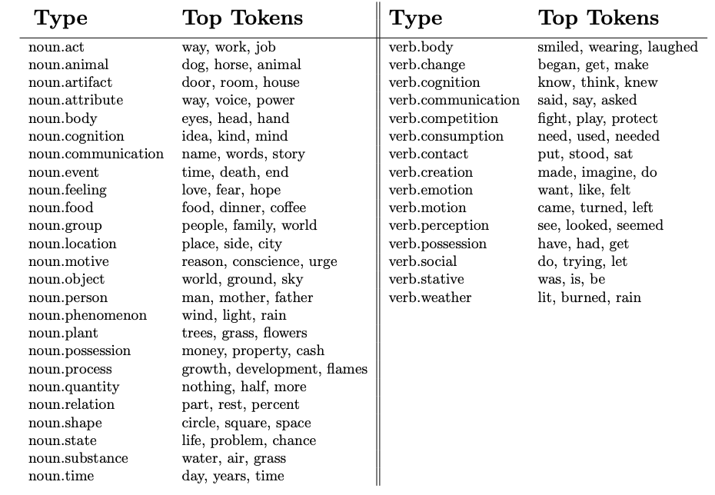
Super-sense tags
bookNLP -> SemCor -> Wordnet

Slide 22
Perceiving Perception
Classification and
Regression Tree algorithm
(CART)
Source: CONLIT

Slide 23
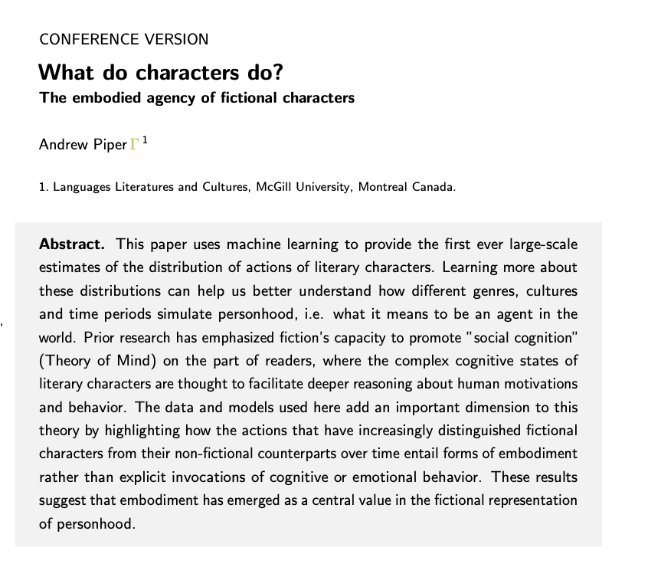
Embodied Agency
Piper, A. “What do characters do? The Embodied Agency of Fictional Characters.” Journal of Computational Literary Studies (2023).

Slide 24
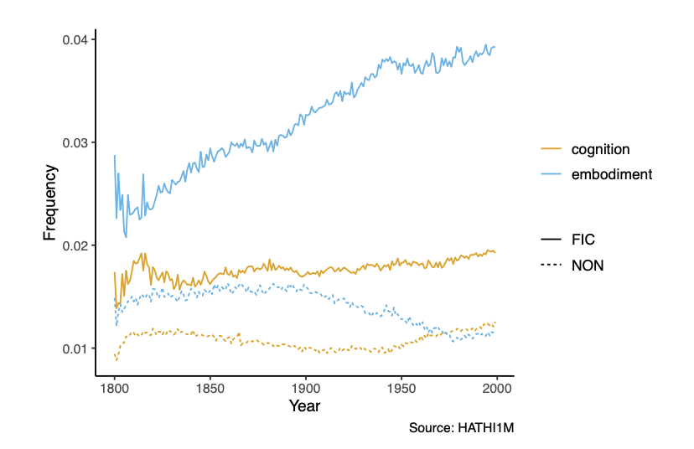
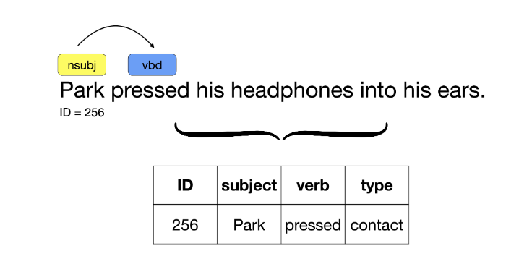
Embodied Agency
https://github.com/booknlp/booknlp

Slide 25
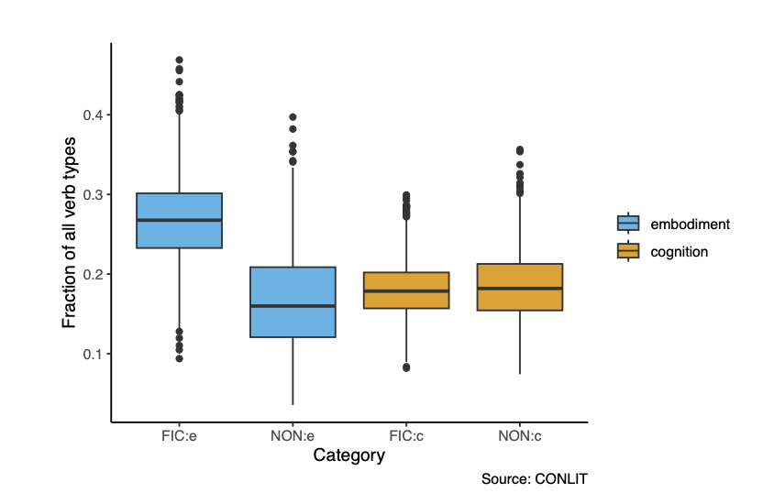
Embodied Agency
https://github.com/booknlp/booknlp

Slide 26
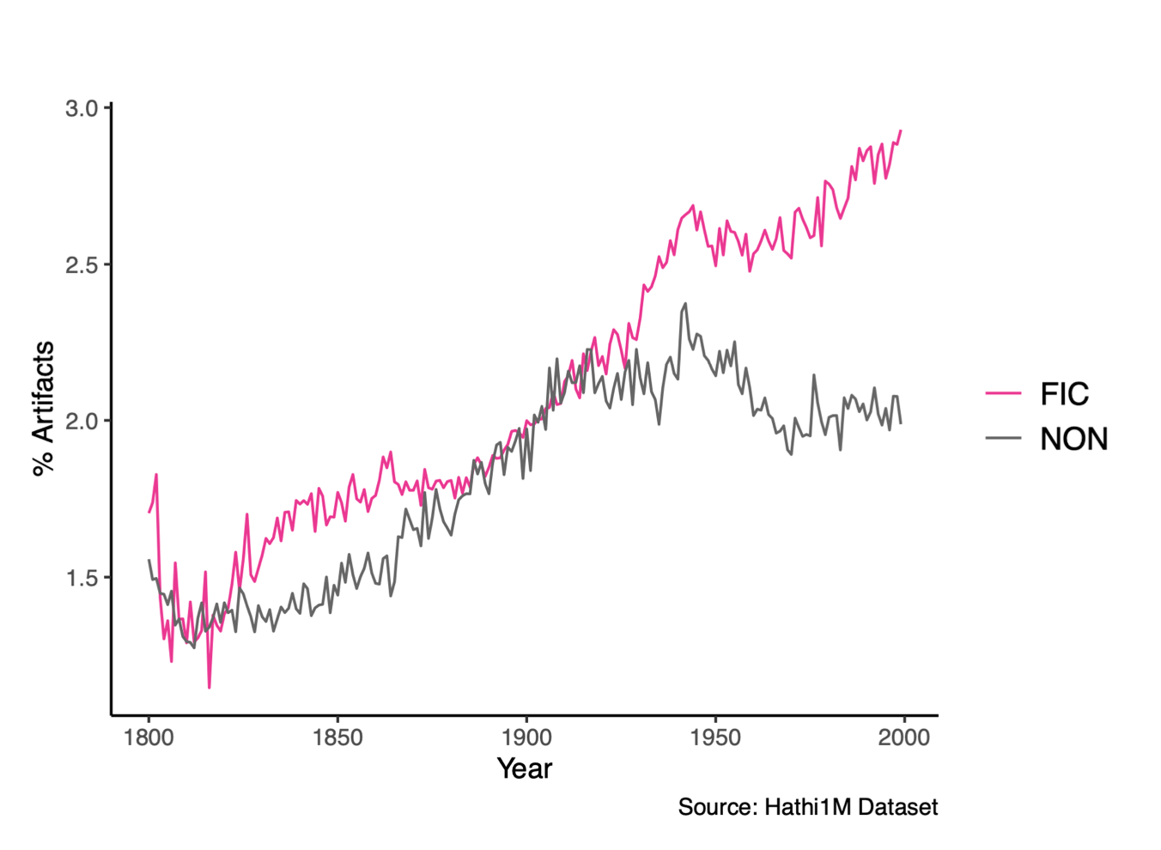
What is the nature of fictional things?
Piper, A. “A Quantitative Study of Fictional Things.” CHR 2022.

Slide 27
Overview
Piper, A. “Computational Narrative Understanding: A Big Picture Analysis.” EMNLP 2023

Slide 28
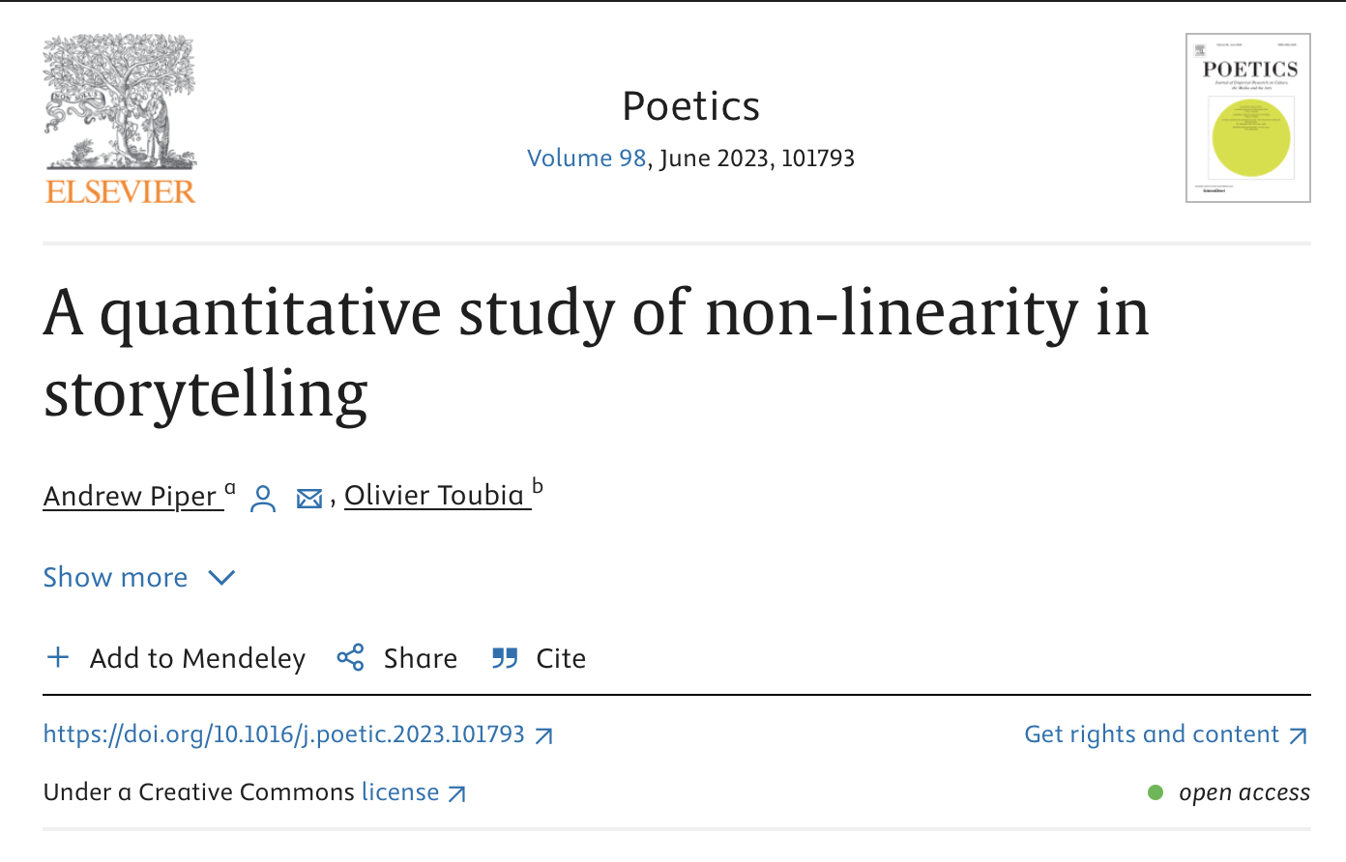
Narrative Shape

Slide 29
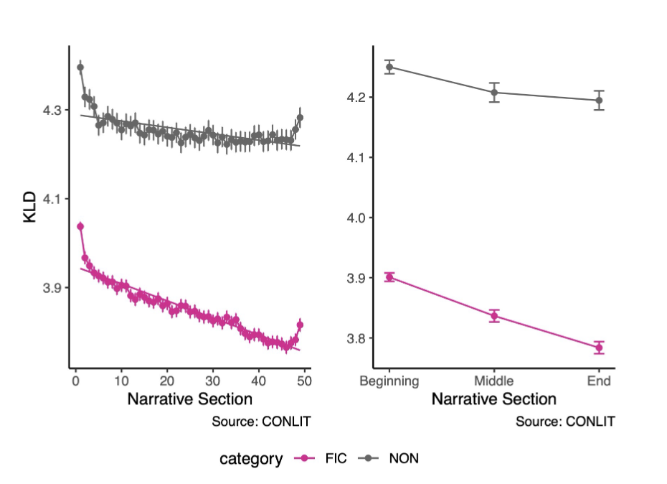
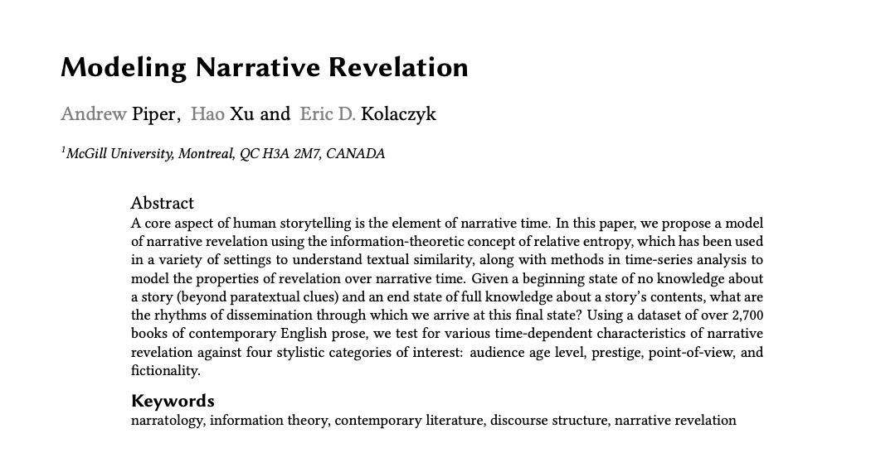
Narrative Shape

Slide 30
Collective Stories

Slide 31
Collective Stories
What is the story of Vermont?
What is the story of Hunter Biden ?
What is the story of the Israel / Palestine conflict?

Slide 32
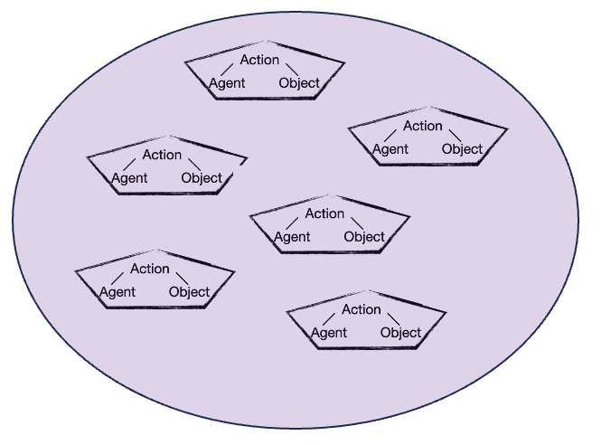
Collective Stories
What is the story of Vermont?
What is the story of Hunter Biden ?
What is the story of the Israel / Palestine conflict?

Slide 33
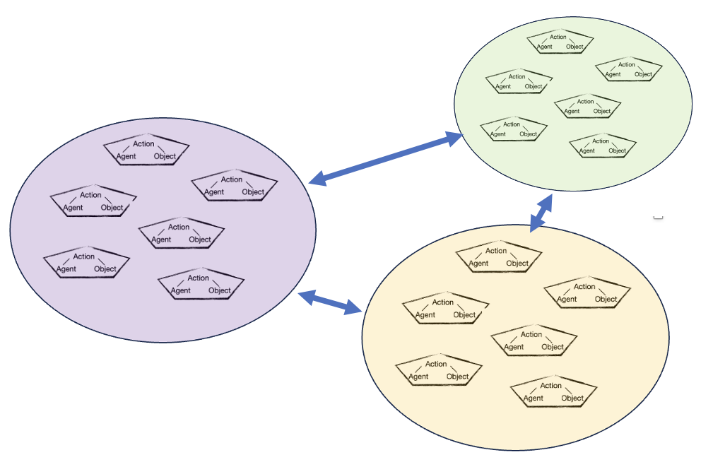
Collective Stories
What is the story of Vermont?
What is the story of Hunter Biden ?
What is the story of the Israel / Palestine conflict?

Slide 34
Collective Stories
What is the story of Vermont?
What is the story of Hunter Biden ?
What is the story of the Israel / Palestine conflict?
Story

Slide 35
Collective Stories
How can we classify these collective stories as types?
Using GPT to extract a “moral” or “meaning” of the story
Prototyping using folk tales

Slide 36
Collective Stories
Typologies
  Broadwell, P., Mimno, D., & Tangherlini, T. (2017). The tell-tale hat: Surfacing the uncertainty in folklore classification. Journal of Cultural Analytics, 2(1).
  Shahsavari, S., Holur, P., Wang, T., Tangherlini, T. R., & Roychowdhury, V. (2020). Conspiracy in the time of corona: automatic detection of emerging COVID-19 conspiracy theories in social media and the news. Journal of computational social science, 3(2), 279-317.
Social Dynamics
  Antoniak, M., Mimno, D., & Levy, K. (2019). Narrative paths and negotiation of power in birth stories. Proceedings of the ACM on Human-Computer Interaction, 3(CSCW), 1-27.

Slide 37
Thank you!

